Slide 1
Gen AI Moodslider 2.0

Slide 2
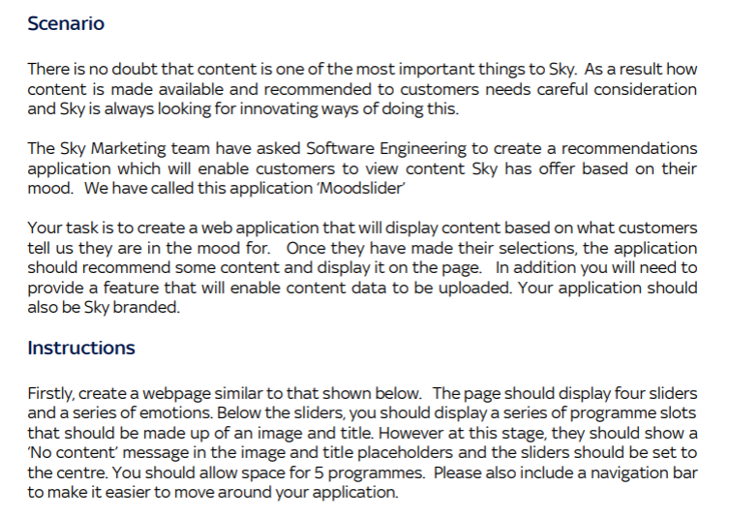
Moodslider task

Slide 3
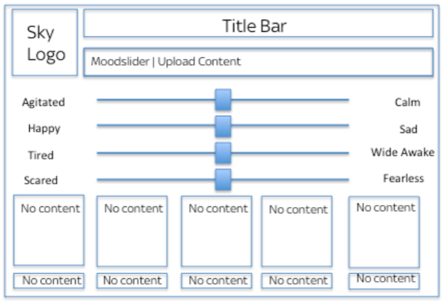

Slide 4
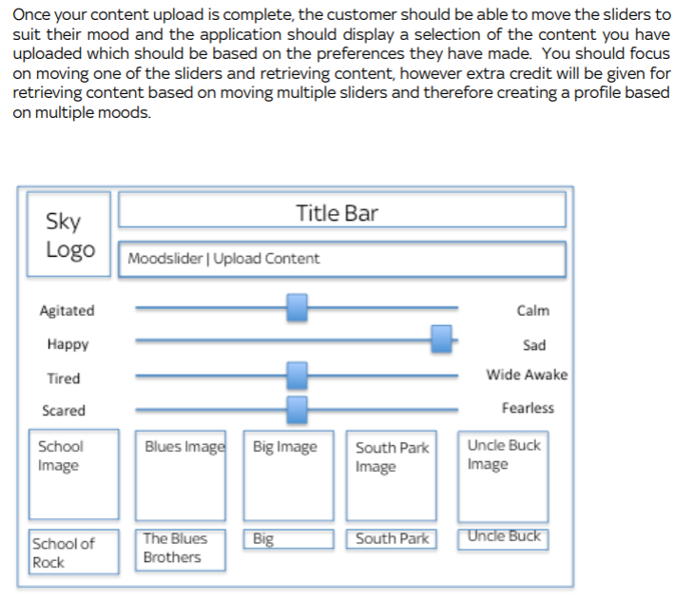

Slide 5
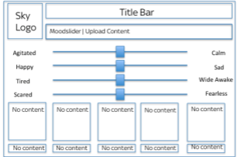
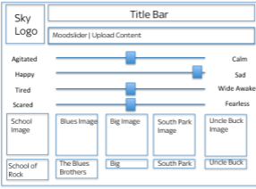
Generative AI | Framework | Playout and Data
Using Teachable machine to recognise facial expressions (sad, happy, angry face etc.) and body language The slider should move based on the facial recognition as per below When the slider moves, images of movies recommended for the mood should display The user should be able to click the play button and watch the recommended movies | Build a frame as below When the slider is moved, it should display movies recommended based on the mood When the play button is clicked, the movie should play | Create a database of movie content/playout database Create a data table that displays the movie names and the numbers of hits for each movie

